Slide 1
Chapter 17
An introduction to database administration

Slide 2
Objectives
Applied
Use MySQL Workbench to kill processes and view status variables and system variables.
Set system variables by using the SET statement or by editing the configuration file for the database server.
Enable and disable different types of logging.
View and manage log files.
Knowledge
Describe the responsibilities of a database administrator.
In general terms, describe how replication works.
Describe the three types of files that are used by a database server.
Describe the general, error, slow query, binary, and relay log files.
Describe processes, status variables, and system variables.

Slide 3
Common database administrator responsibilities
Maintenance
Monitor the server
Configure the server
Maintain log files
Design
Design the database
Create the database
Security
Maintain user accounts
Secure the server and its databases

Slide 4
Common database administrator responsibilities (continued)
Backup
Backup the database regularly
Restore the database
Migrate data to another server
Miscellaneous
Start or stop the server
Optimize the server
Update software
Enable and manage replication

Slide 5
Types of database files
Configuration
Data
Log
Types of log files
General
Error
Slow query
Binary
Relay

Slide 6
The base and data directories for Windows
C:\Program Files\MySQL\MySQL Server 8.0
C:\ProgramData\MySQL\MySQL Server 8.0\data
The base and data directories for macOS and Unix/Linux
usr/local/mysql/
usr/local/mysql/data

Slide 7
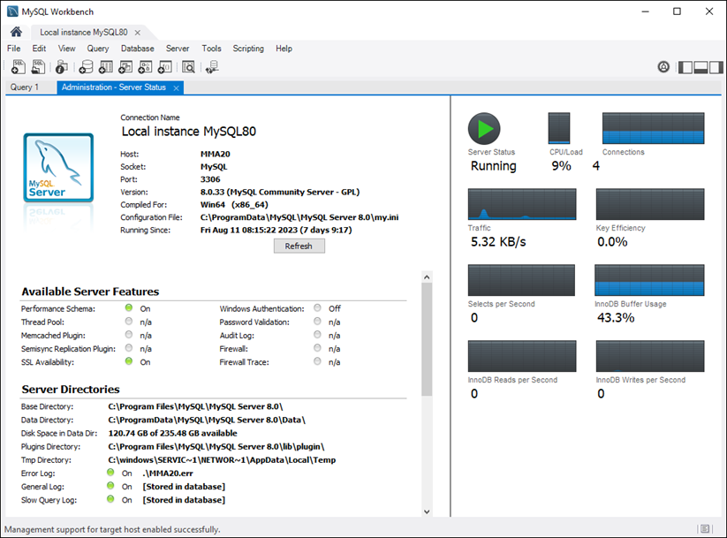
The Server status window

Slide 8
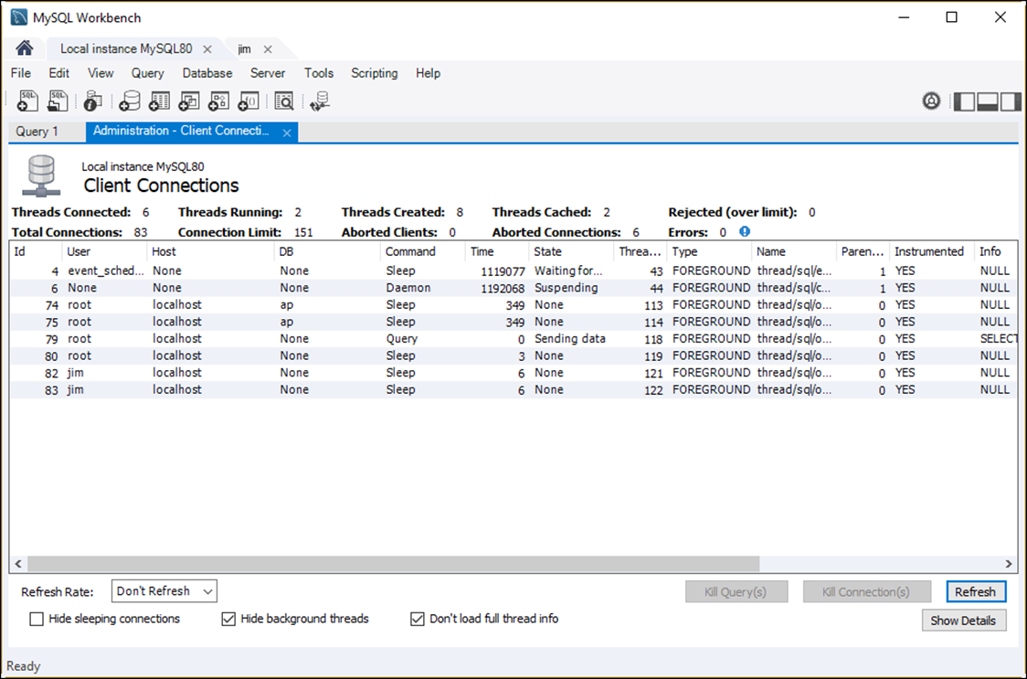
The process list

Slide 9
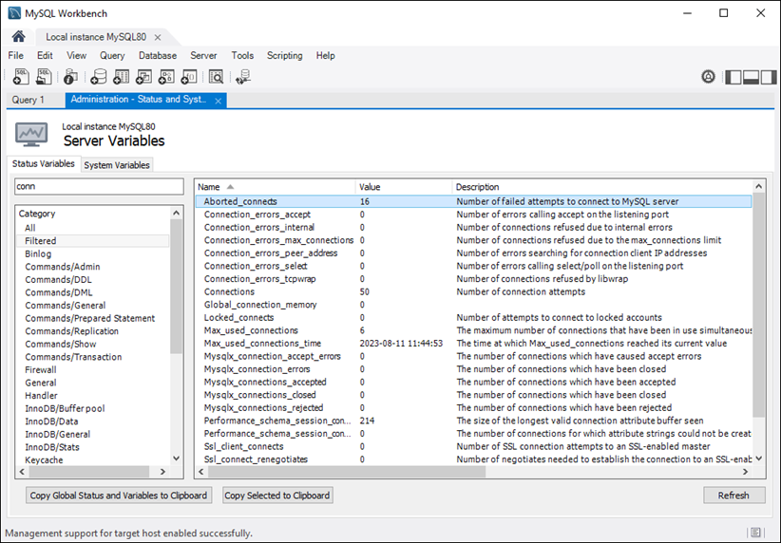
Status variables

Slide 10
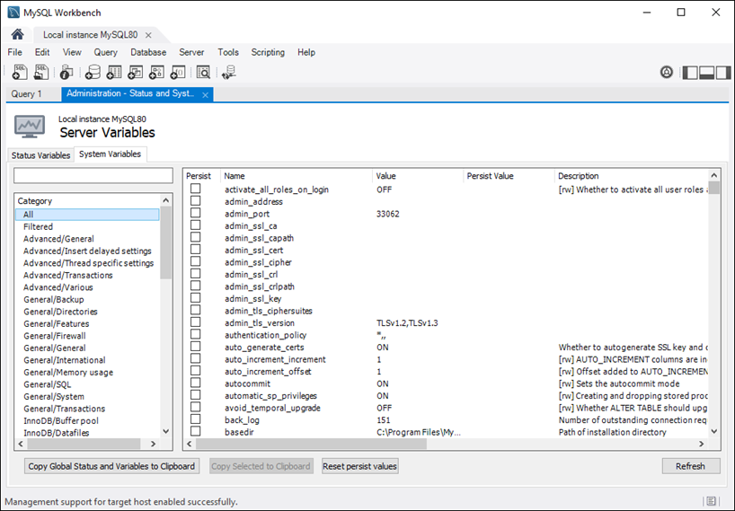
System variables

Slide 11
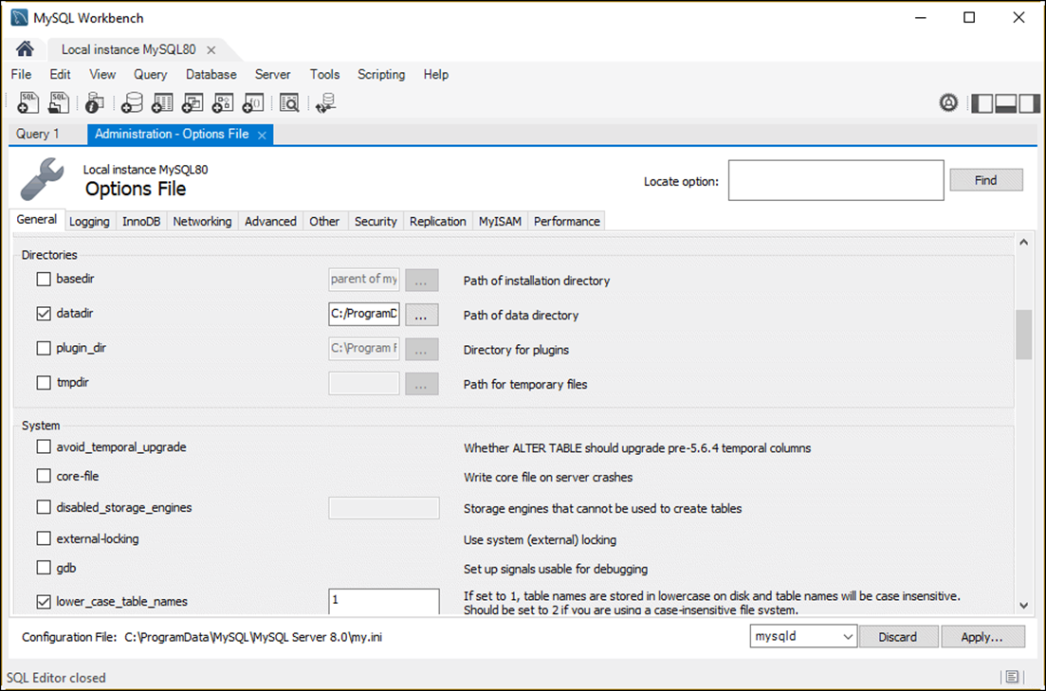
Server configuration options

Slide 12
Part of a configuration file for Windows
[mysqld]
port=3306
basedir="C:/Program Files/MySQL/MySQL Server 8.0/"
datadir=C:/ProgramData/MySQL/MySQL Server 8.0/Data
character-set-server=utf8mb4
default-storage-engine=INNODB
default_authentication_plugin=caching_sha2_password
sql-mode="STRICT_TRANS_TABLES,NO_ENGINE_SUBSTITUTION"
log-output=FILE
general-log=0
general_log_file="JOEL-PC.log"
slow-query-log=1
slow_query_log_file="JOEL-PC-slow.log"
long_query_time=10
log-bin="JOEL-PC-bin"
log-error="JOEL-PC.err"
server-id=1
lower_case_table_names=1
secure-file-priv="C:/ProgramData/MySQL/MySQL Server 8.0/Uploads"
max_connections=151
table_open_cache=2000
tmp_table_size=35M
thread_cache_size=10

Slide 13
Part of a configuration file for Windows (cont.)
#*** MyISAM Specific options
myisam_max_sort_file_size=100G
myisam_sort_buffer_size=62M
key_buffer_size=8M
read_buffer_size=64K
read_rnd_buffer_size=256K
#*** INNODB Specific options ***
innodb_flush_log_at_trx_commit=1
innodb_log_buffer_size=1M
innodb_buffer_pool_size=8M
innodb_log_file_size=48M
innodb_thread_concurrency=9
Note
The configuration file is named my.ini (Windows) or my.cnf (macOS or Unix/Linux).

Slide 14
The syntax for setting a system variable
Global variables
SET GLOBAL var_name = var_value;
Session variables
SET [SESSION] var_name = var_value;
Examples that set system variables
SET GLOBAL autocommit = ON;
SET SESSION autocommit = OFF;
SET GLOBAL autocommit = DEFAULT;
SET GLOBAL max_connections = 90;
SET GLOBAL max_connections = DEFAULT;
SET GLOBAL tmp_table_size = 36700160;
SET GLOBAL tmp_table_size = 35 * 1024 * 1024;

Slide 15
The syntax for getting a system variable
Global variable
@@GLOBAL.var_name
Session variable
@@[SESSION.]var_name
Examples that get system variables
Get the global and session values of a variable
SELECT @@GLOBAL.autocommit, @@SESSION.autocommit
Get the session value if it exists or the global value if it doesn’t
SELECT @@autocommit

Slide 16
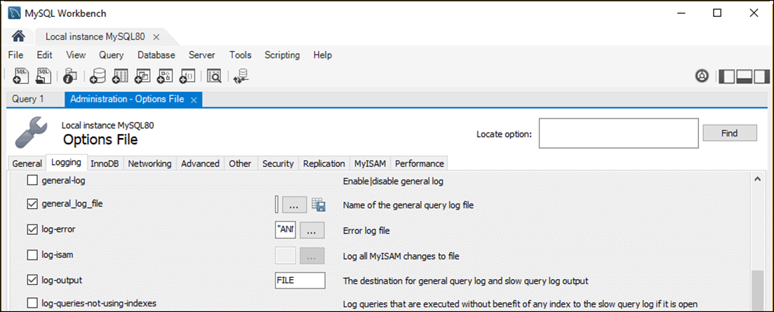
Server configuration options for log files

Slide 17
System variables for enabling logging
general_log
general_log_file=logname
log_error[=logname]
log_bin[=logname]
slow_query_log
slow_query_log_file=logname

Slide 18
Logging options for enabling logging in the configuration file
general_log
general_log_file = "/murach/mysql/general.log"
log_error = "/murach/mysql/error.log"
log_bin = "/murach/mysql/bin-log"
slow_query_log
slow_query_log_file = "/murach/mysql/slow.log"

Slide 19
System variables that apply to multiple logs
log_output[=target]
log_error_verbosity[=level]
System variables for the binary log
expire_logs_days[=days]
max_binlog_size[=bytes]
A system variable for the slow query log
long_query_time[=seconds]

Slide 20
Logging options set in the configuration file
# stores the output of the general and slow query logs
# in a table
log_output = TABLE
# logs errors, warnings, and informational messages
log_warnings = 2
# deletes binary log files that are more than 7 days old
expire_logs_days = 7
# sets the maximum binary log file size to 1MB
max_binlog_size = 1048576
# writes queries to the slow query log if they take
# longer than 5 seconds
long_query_time = 5

Slide 21
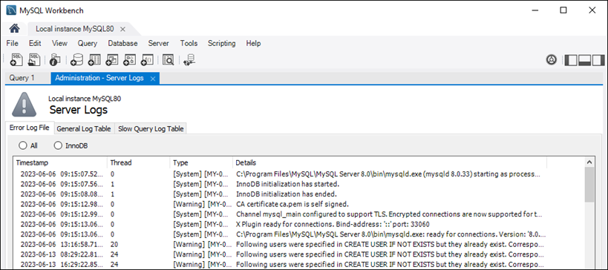
The error log displayed in MySQL Workbench

Slide 22
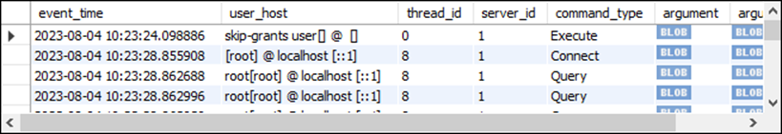
How to view log files written to tables
The general log
SELECT *, CHAR(argument) AS argument_text FROM mysql.general_log
The slow query log
SELECT * FROM mysql.slow_log

Slide 23
Strategies for managing logs
Strategy Applies to
Log rotation Text-based logs (general, error, and slow query)
Age-based expiration The binary log

Slide 24
An event that rotates the general log every month
USE mysql;
DELIMITER //
CREATE EVENT general_log_rotate
ON SCHEDULE EVERY 1 MONTH
DO BEGIN
DROP TABLE IF EXISTS general_log_old;
CREATE TABLE general_log_old AS
SELECT *
FROM general_log;
TRUNCATE general_log;
END//

